Slide 1
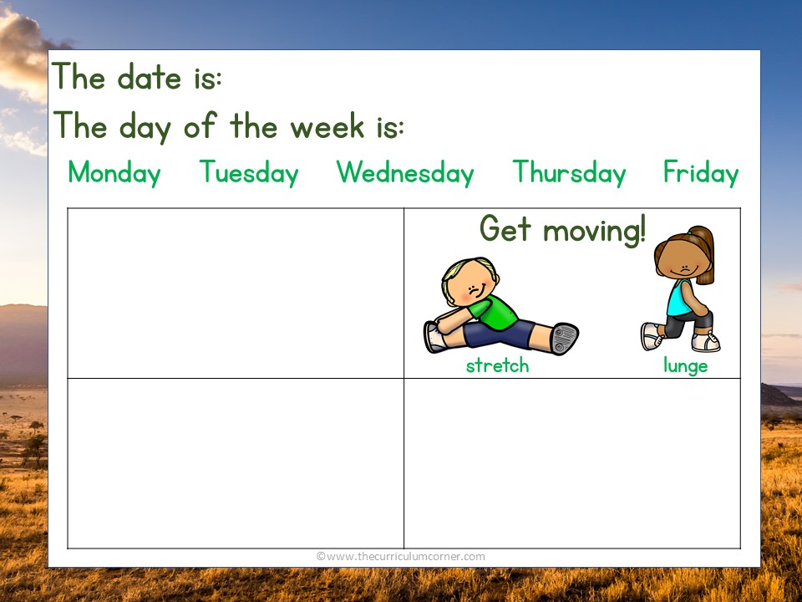
Kindness is free. Sprinkle it everywhere!
Add a math problem here
Add a reading question here

Slide 2
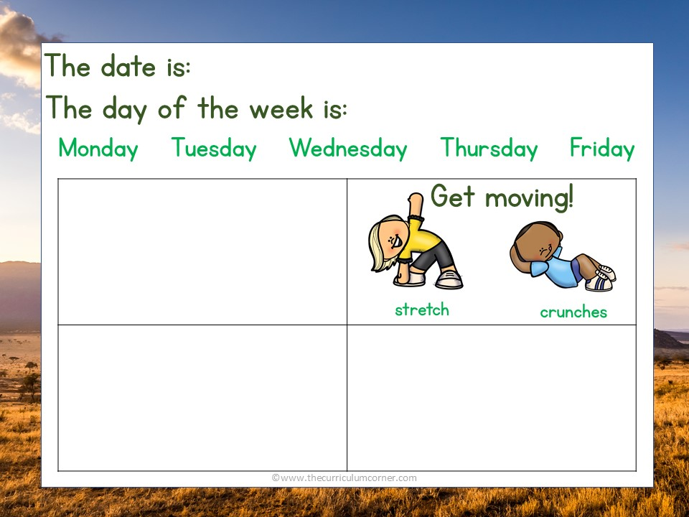
Attitude is the difference between an ORDEAL and an ADVENTURE!
Add a math problem here
Add a reading question here

Slide 3
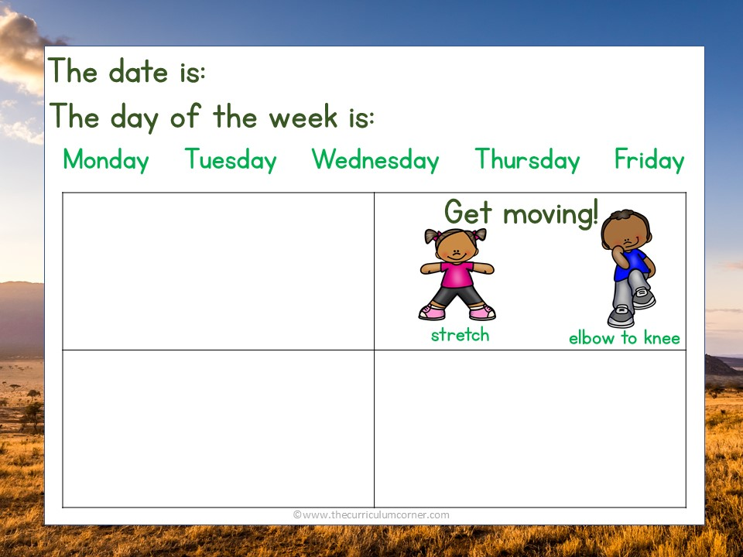
If we all make today awesome for somebody else, today will be awesome for everybody.
~Kid President
Add a math problem here
Add a reading question here

Slide 4
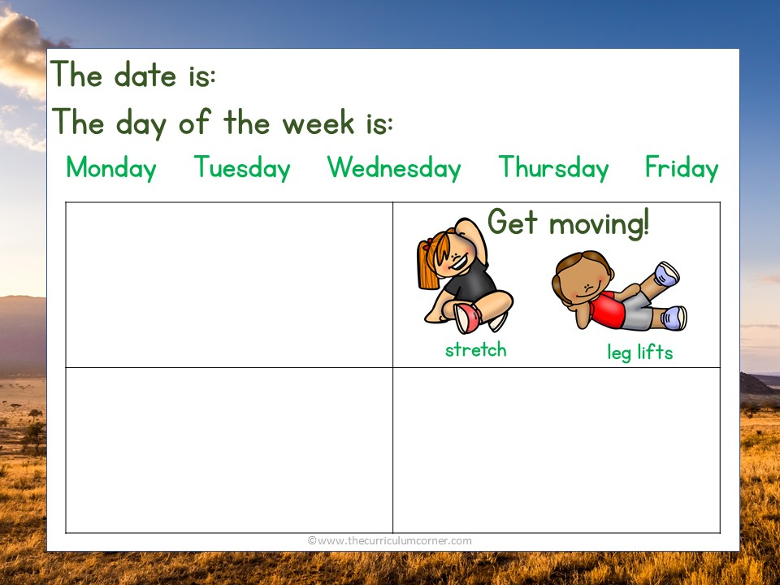
Every accomplishment starts with the decision to try.
Add a math problem here
Add a reading question here

Slide 5
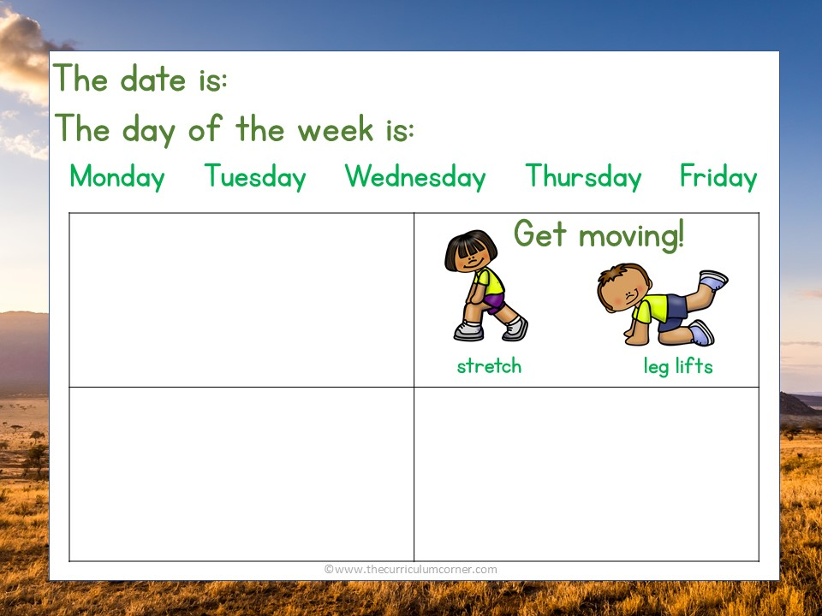
Try to be a rainbow in someone’s cloud.
~Maya Angelou
Add a math problem here
Add a reading question here

